Slide 1

E-commerce site
Presented by Admond Tamang
Batch 21

Slide 2
Introduction
E-commerce refers to the sale of goods or products through online Stores.
The main purpose of e-commerce site is that any person can buy as well as sell products.

Slide 3
Problem statement
Direct chat with seller
Online payment system
Not supportive to local market

Slide 4
Aims and objectives
Help user find the specific products.
Sell their products and earn money.
Encourage local markets.
To reduce cost.

Slide 5
Features
Shopping cart
Checkout system
Payment system
Searching product
Browse through store

Slide 6
Work Breakdown structure
E-commerce
Project Managment
Analysis
Design
Implementation
Testing
Risk Management
WBS
Configuration Management
Proposal Submission
Requirement Analysis
Structural Model
Build Database
Unit Testing
Analysis Specification
Use Case
Architecture
Behavioural Model
UI design
Database Design
Coding
Black box Testing
White box Testing
Integration Testing
Deployment
User Training
Final Report

Slide 7
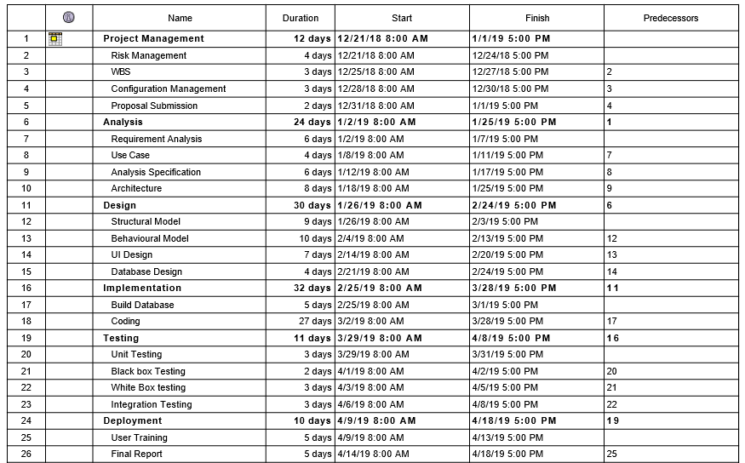
Gantt Chart-1

Slide 8
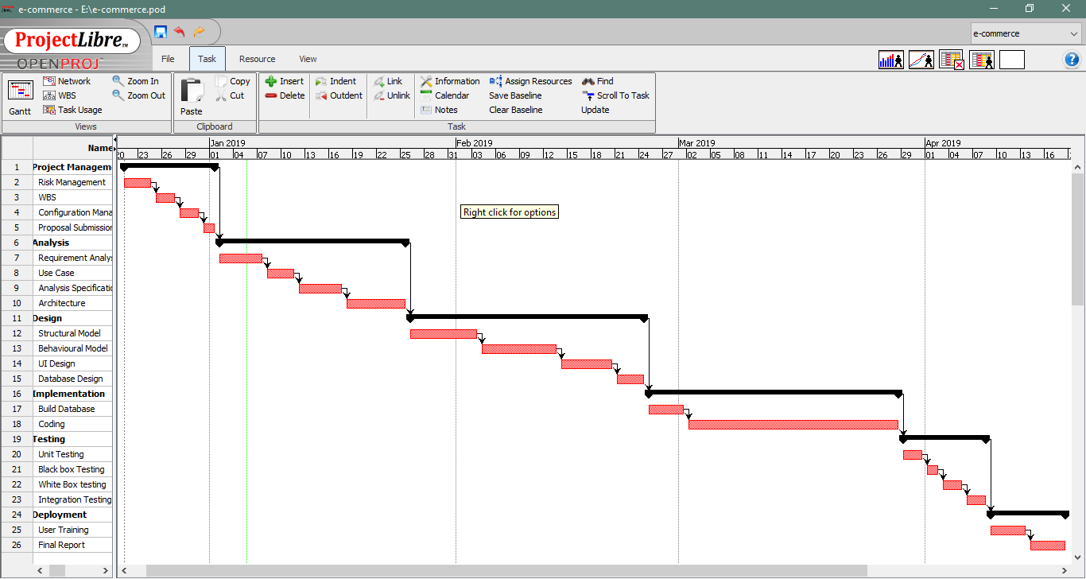
Gantt Chart-2

Slide 9
Waterfall Methodology
Project Management
Analysis
Implementation
Design
Deployment
Testing

Slide 10
Waterfall Methodology
The waterfall methodology was used because of following reasons:
It is simple and easy to understand.
Progress of my project can be tracked easily.
My project has clear requirement, so I think waterfall model is suitable for my project.

Slide 11
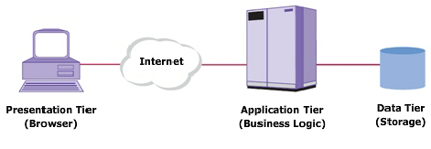
3-tier architecture
Presentation
Application
Data tier

Slide 12
Risk management
Impact = Likelihood * Consequences
S. No | Risks | Likelihood | Consequences | Impact | Solution
 | Lack of staff training | 2 | 3 | 6 | At the stage of deployment, staff should be trained properly to use the system.
 | Data theft | 3 | 4 | 12 | Strong company policy should be established.
 | Failure to meet requirement | 2 | 4 | 12 | Proper planning is to be done in every phase.
 | DDOS attack | 1 | 4 | 4 | Placing the publicly exposed server in DMZ.
 | Database error | 1 | 5 | 5 | Analyze the data traffic and upgrade the hardware if necessary.
 | Server failure | 1 | 5 | 5 | IT security should be hired to look after the server.
 | Change in government policy | 1 | 5 | 5 | Should be aware about the situation of the country and make changes accordingly.

Slide 13
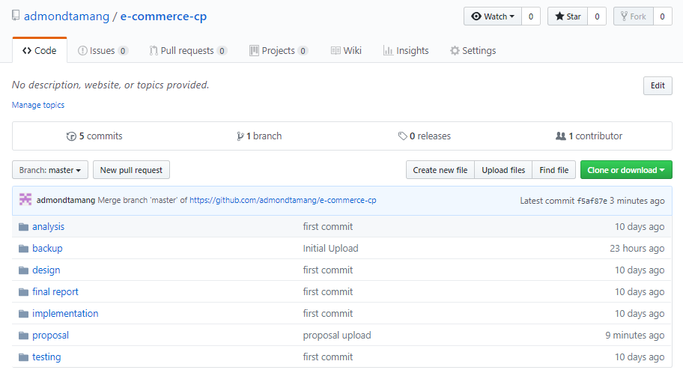
Configuration management
I used github to keep track of my project.

Slide 14
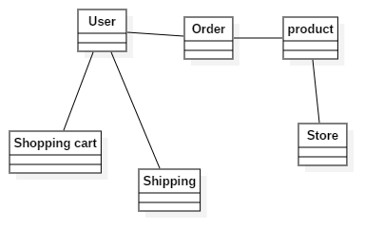
Design: initial Class diagram

Slide 15
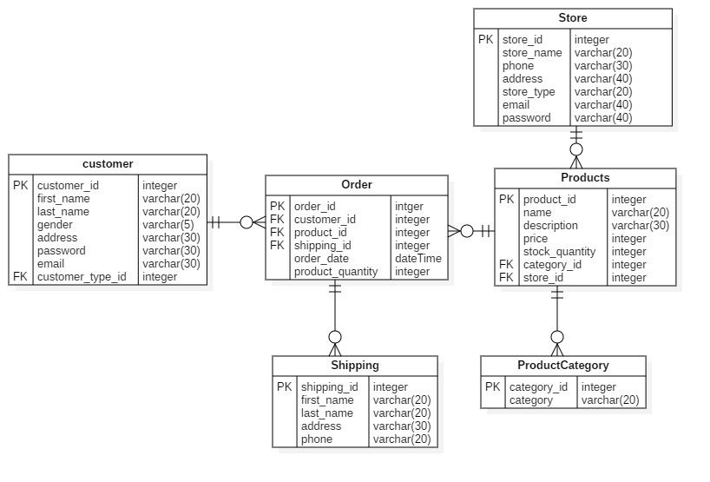
Er-diagram

Slide 16
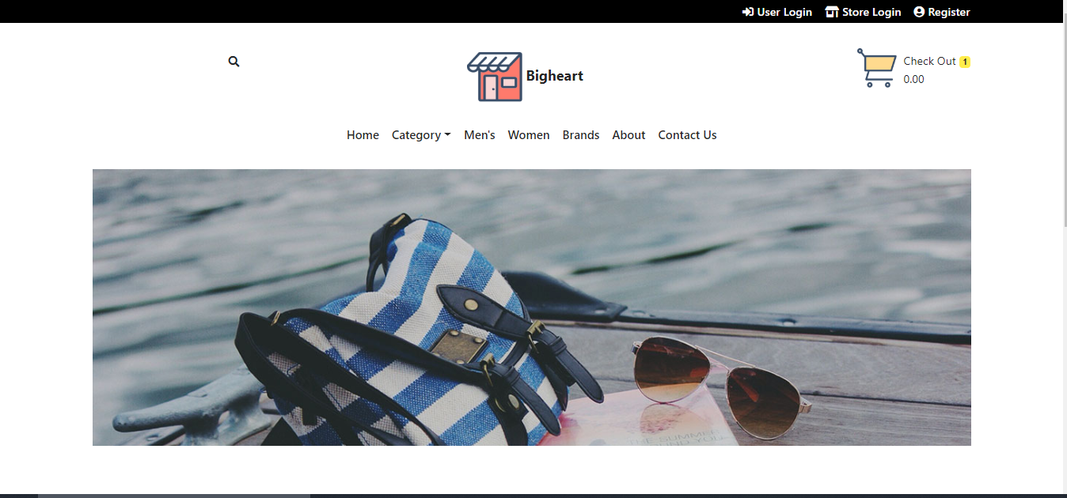
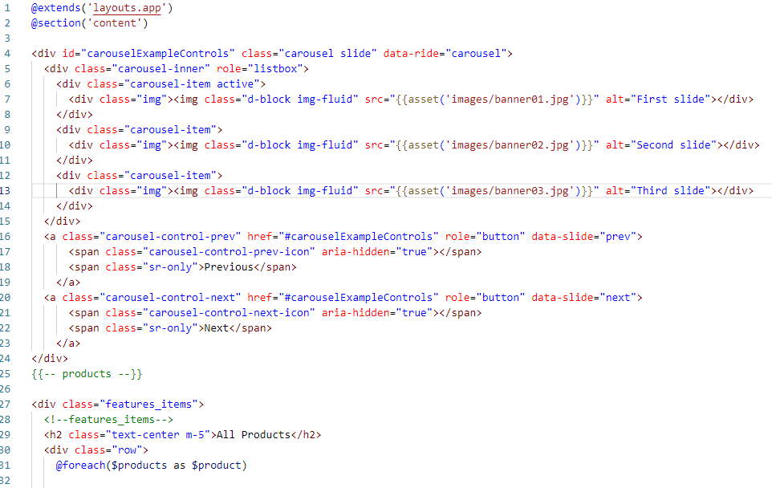
UI design and code

Slide 17
Home page-code

Slide 18
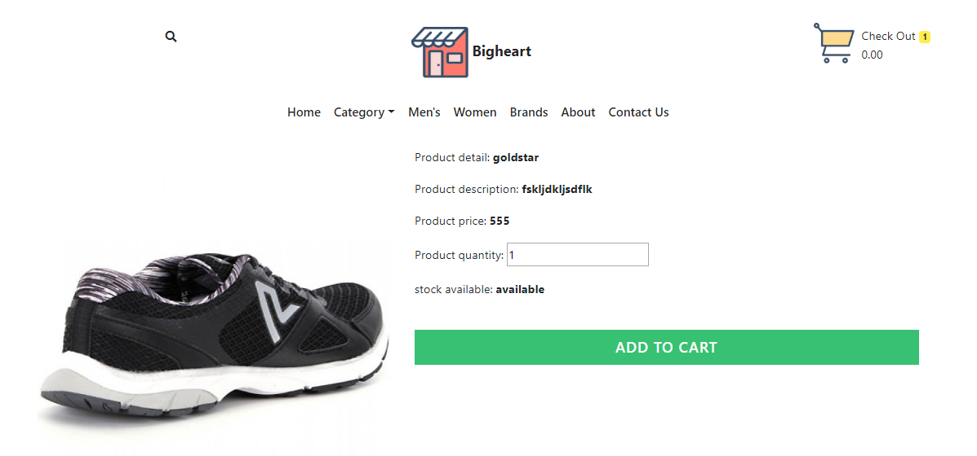
Product detail- design

Slide 19
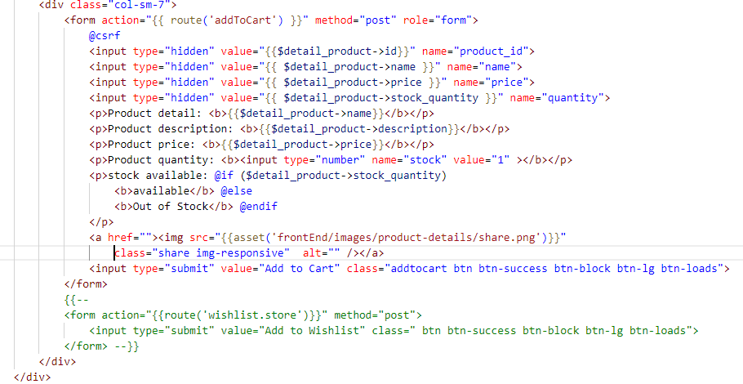
Product detail- code

Slide 20
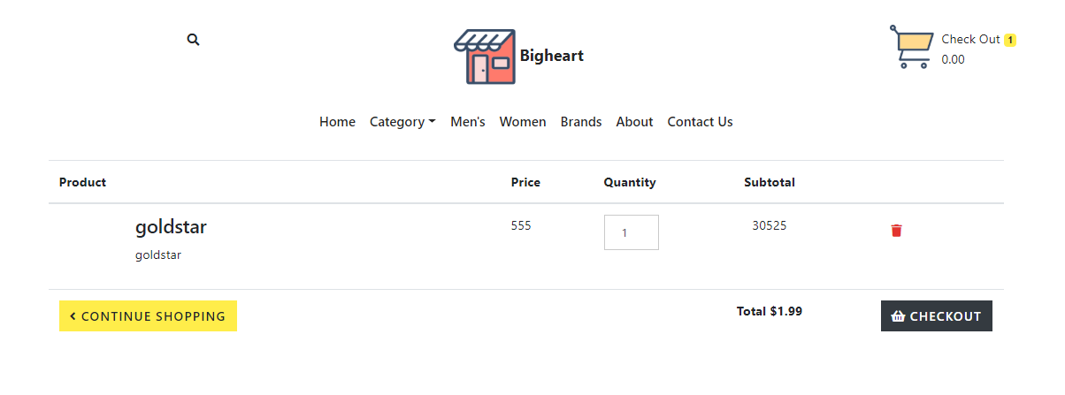
cart Ui

Slide 21
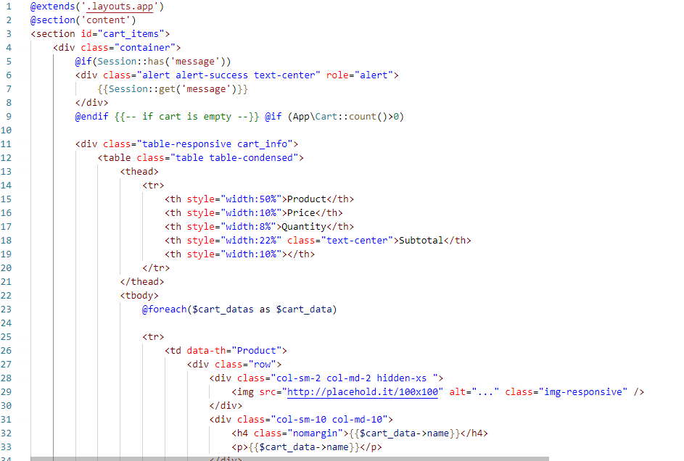
Cart code

Slide 22
LIMITATION
Delivery manages
Track products
Money protection
Payment system

Slide 23
Unit Testing
One test for one function.
Each method test one thing only.
Only one assert in one method.
Independent test. No data sharing between test.

Slide 24
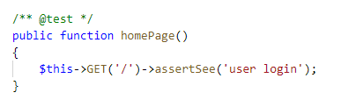
Test case 1
Test case no | 1
Purpose of test | To check route is working
Test data
Expected result | Visit home page
Actual Result | Successfully visited
Class | testLogin

Slide 25
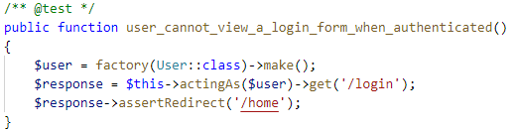
Test case 2
Test case no | 2
Purpose of test | To check user can login without authentication
Test data
Expected result | Redirect to login
Actual Result | Redirected to login
Class | testLogin, UserFactory

Slide 26
Future work
Make payment system
User can sign up with social media like facebook, google etc
GUI modification for more interactive experience.
Real time chat system

Slide 27
Conclusion
By using electronic technology through the internet, it achieved.
More competitions, more marketplaces, faster transactions, and more advanced technologies
To make activities between customers and producers more active.
We as customers and internet users are responsible to keep our e-commerce healthy and safe so that e-business can be more reliable in the future

